Slide 1
Practical – 3 GIT & GITHUB
Aruna Kumbhar

Slide 2
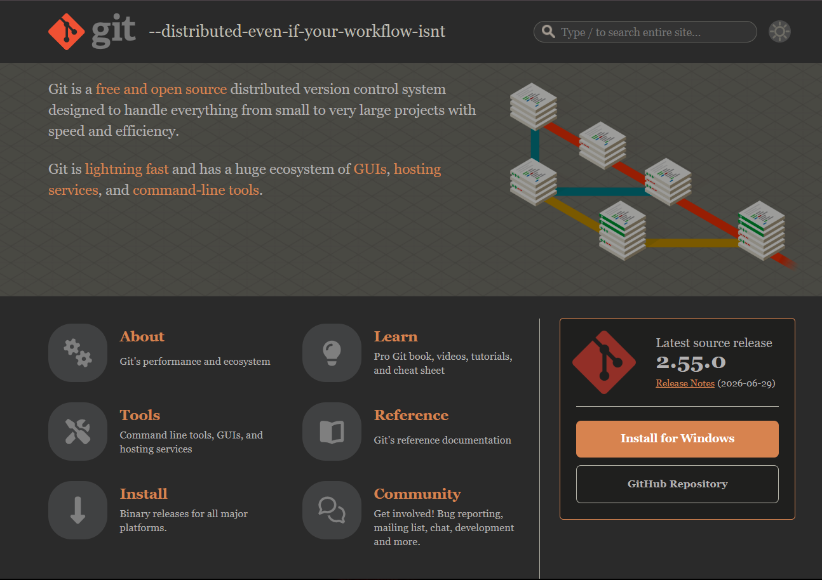
git-scm.com

Slide 3
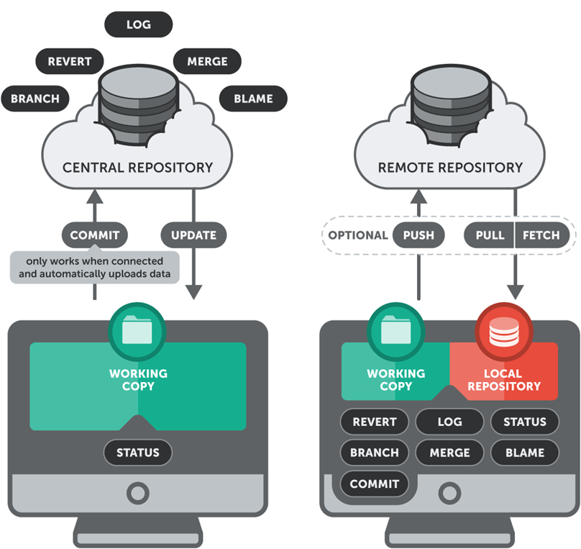
Centralized vs. Distributed

Slide 4
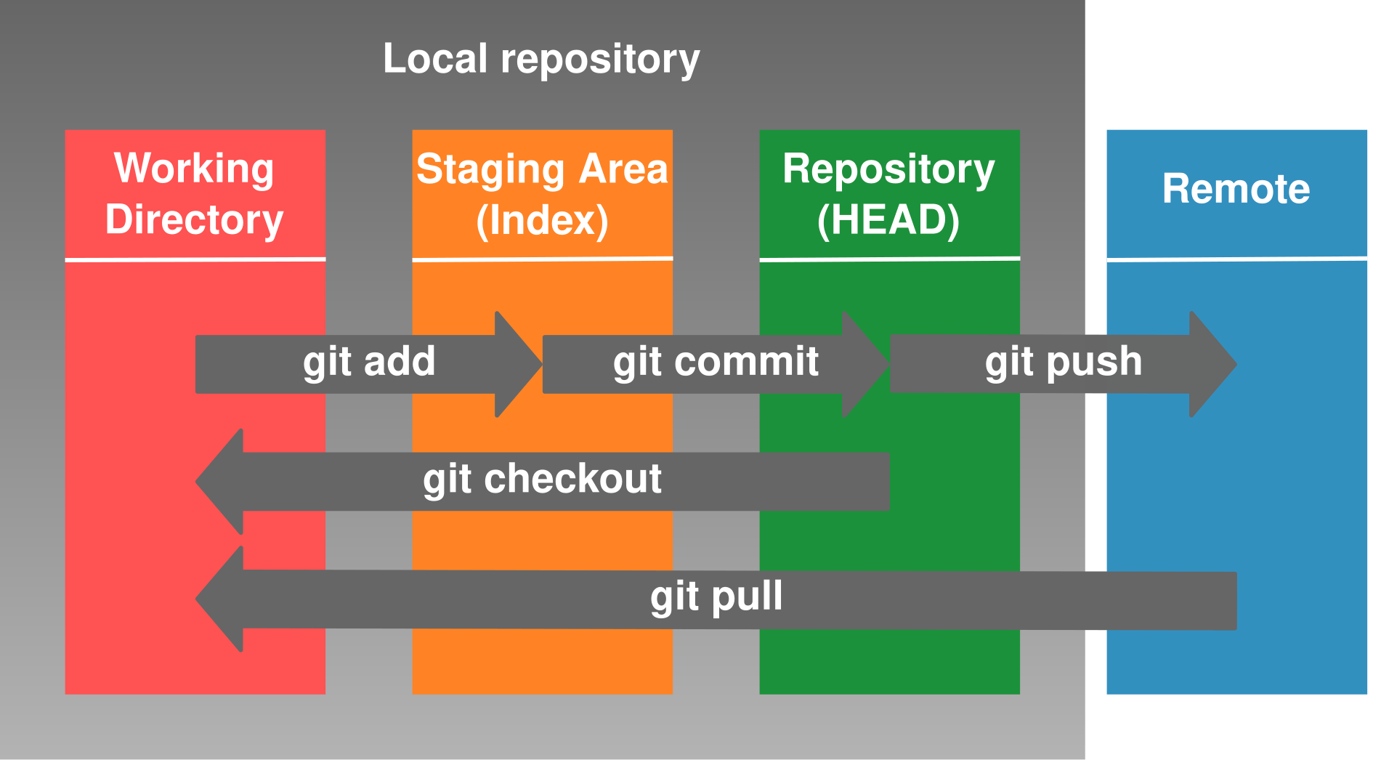

Slide 5
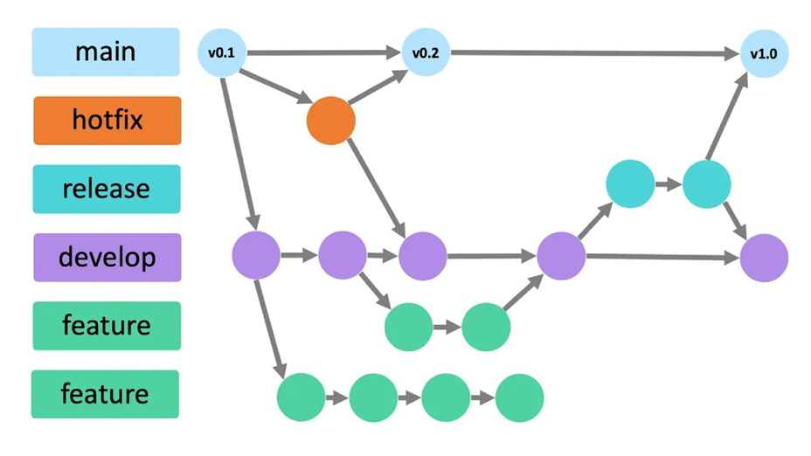
Branching Strategy

Slide 6
Pull Requests
Imagine the restaurant has a "Master Menu" (the main branch) that customers eat from every day
You cannot just sneak a new dish onto it without testing
1. You go to a private kitchen to experiment with a new recipe – this is branching
2. Once the recipe is perfect, you plate it and ask the Head Chef: "Can you review this and add it to the Master Menu?" - This is the PR (Pull Request).
3. The team tastes it. The Head Chef checks your ingredients (Code Review), and the Health Inspector ensures it is safe (Automated Testing)
4. Once everyone gives a thumbs-up, the Head Chef officially prints your taco onto the Master Menu. Your code is now merged for everyone to use!

Slide 7
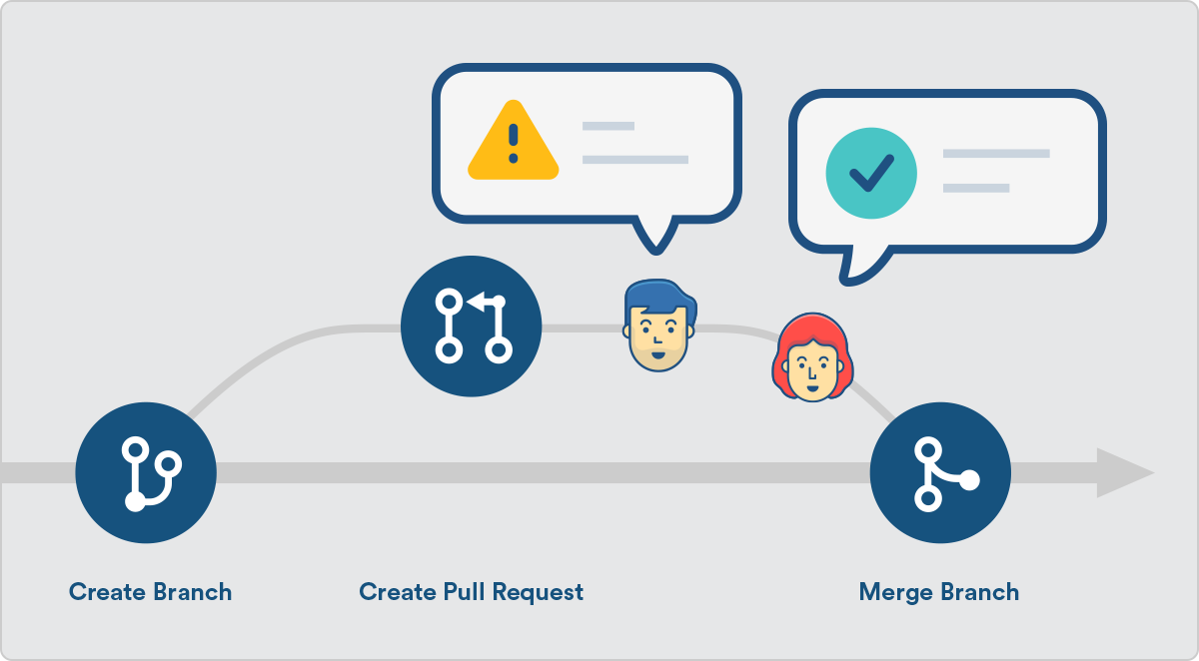
Pull Requests

Slide 8
git --version
git init
git config --global user.name "your Name" git config --global user.email "your.email@example.com"
git status / git diff
git add . / (file name)
git commit -m “commit message"
git remote add origin https://github.com/repo name
git push --set-upstream origin main

Slide 9
git clone “link”
git branch -m <old-name> <new-name>
git checkout –b “branch name”
git rm [file]
git checkout “branch name”
git log
git pull origin main
git branch -d “branch name”
git log --oneline
git revert “commit id”
git merge

Slide 10
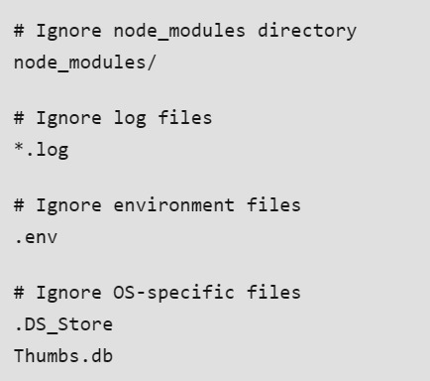
Git Ignore
Git Ignore is an important feature in Git that allows you to specify which files and directories should be excluded from being tracked in a repository
The .gitignore file is a simple text file that tells Git which files or directories to ignore in a project

